Slide 1
Cryptocurrencies
Can we predict changes to the price of
a cryptocurrency based on social media?
Razi Ali Saleh and Aaron Katzin

Slide 2

What is a cryptocurrency?
Cryptocurrency is a digital or virtual currency that is secured by cryptography, which makes it nearly impossible to counterfeit or double-spend. Many cryptocurrencies are decentralized networks based on blockchain technology—a distributed ledger enforced by a disparate network of computers. A defining feature of cryptocurrencies is that they are generally not issued by any central authority, rendering them theoretically immune to government interference or manipulation.

Slide 3




Popular cryptocurrencies
Bitcoin
Binance Coin
Ethereum
Cardano
Tether
Ripple

Slide 4
Analysis Steps
Exploring Data
Obtaining Data
Interpreting Data
Exploring the relationships between certain parameters and cryptocurrency price fluctuations
Twint Python library for crawling Twitter and other web crawling
Understanding the results and applying the chosen algorithm
1
2
3
4
5
Cleaning and Transforming Data
Data Modeling
Clearing useless parameters.
Cleaning out or filling null values.
Summarizing raw data into daily statistics.
Deciding which ML algorithm is most accurate for our predictions

Slide 5
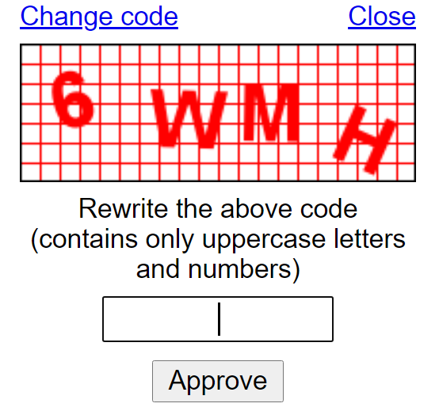
Obtaining Data
Twint Python Library
We used Twint to query tweets and their metadata in the given time range that included specific keywords. In our experiment the keywords were ‘BTC’ and ‘Bitcoin’.
On average we received one million tweets per week.
Web Crawling
We crawled stooq.com to get the average price of the S&P 500 index which is a measure of the overall stock market.
While crawling for the price of the S&P 500 index we ran into the usual captcha problem. Every few queries we needed to manually fill out the captcha. We also needed to switch networks a few times in order to unblock the crawler.

Slide 6
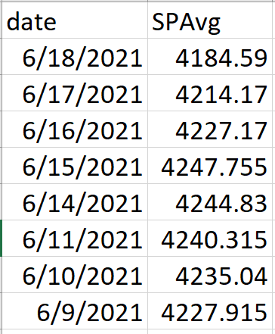
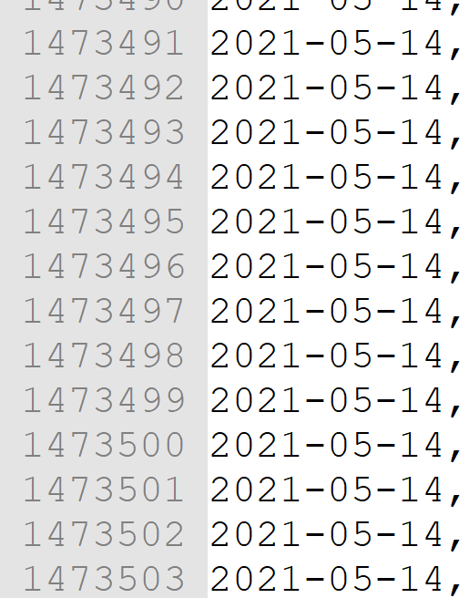
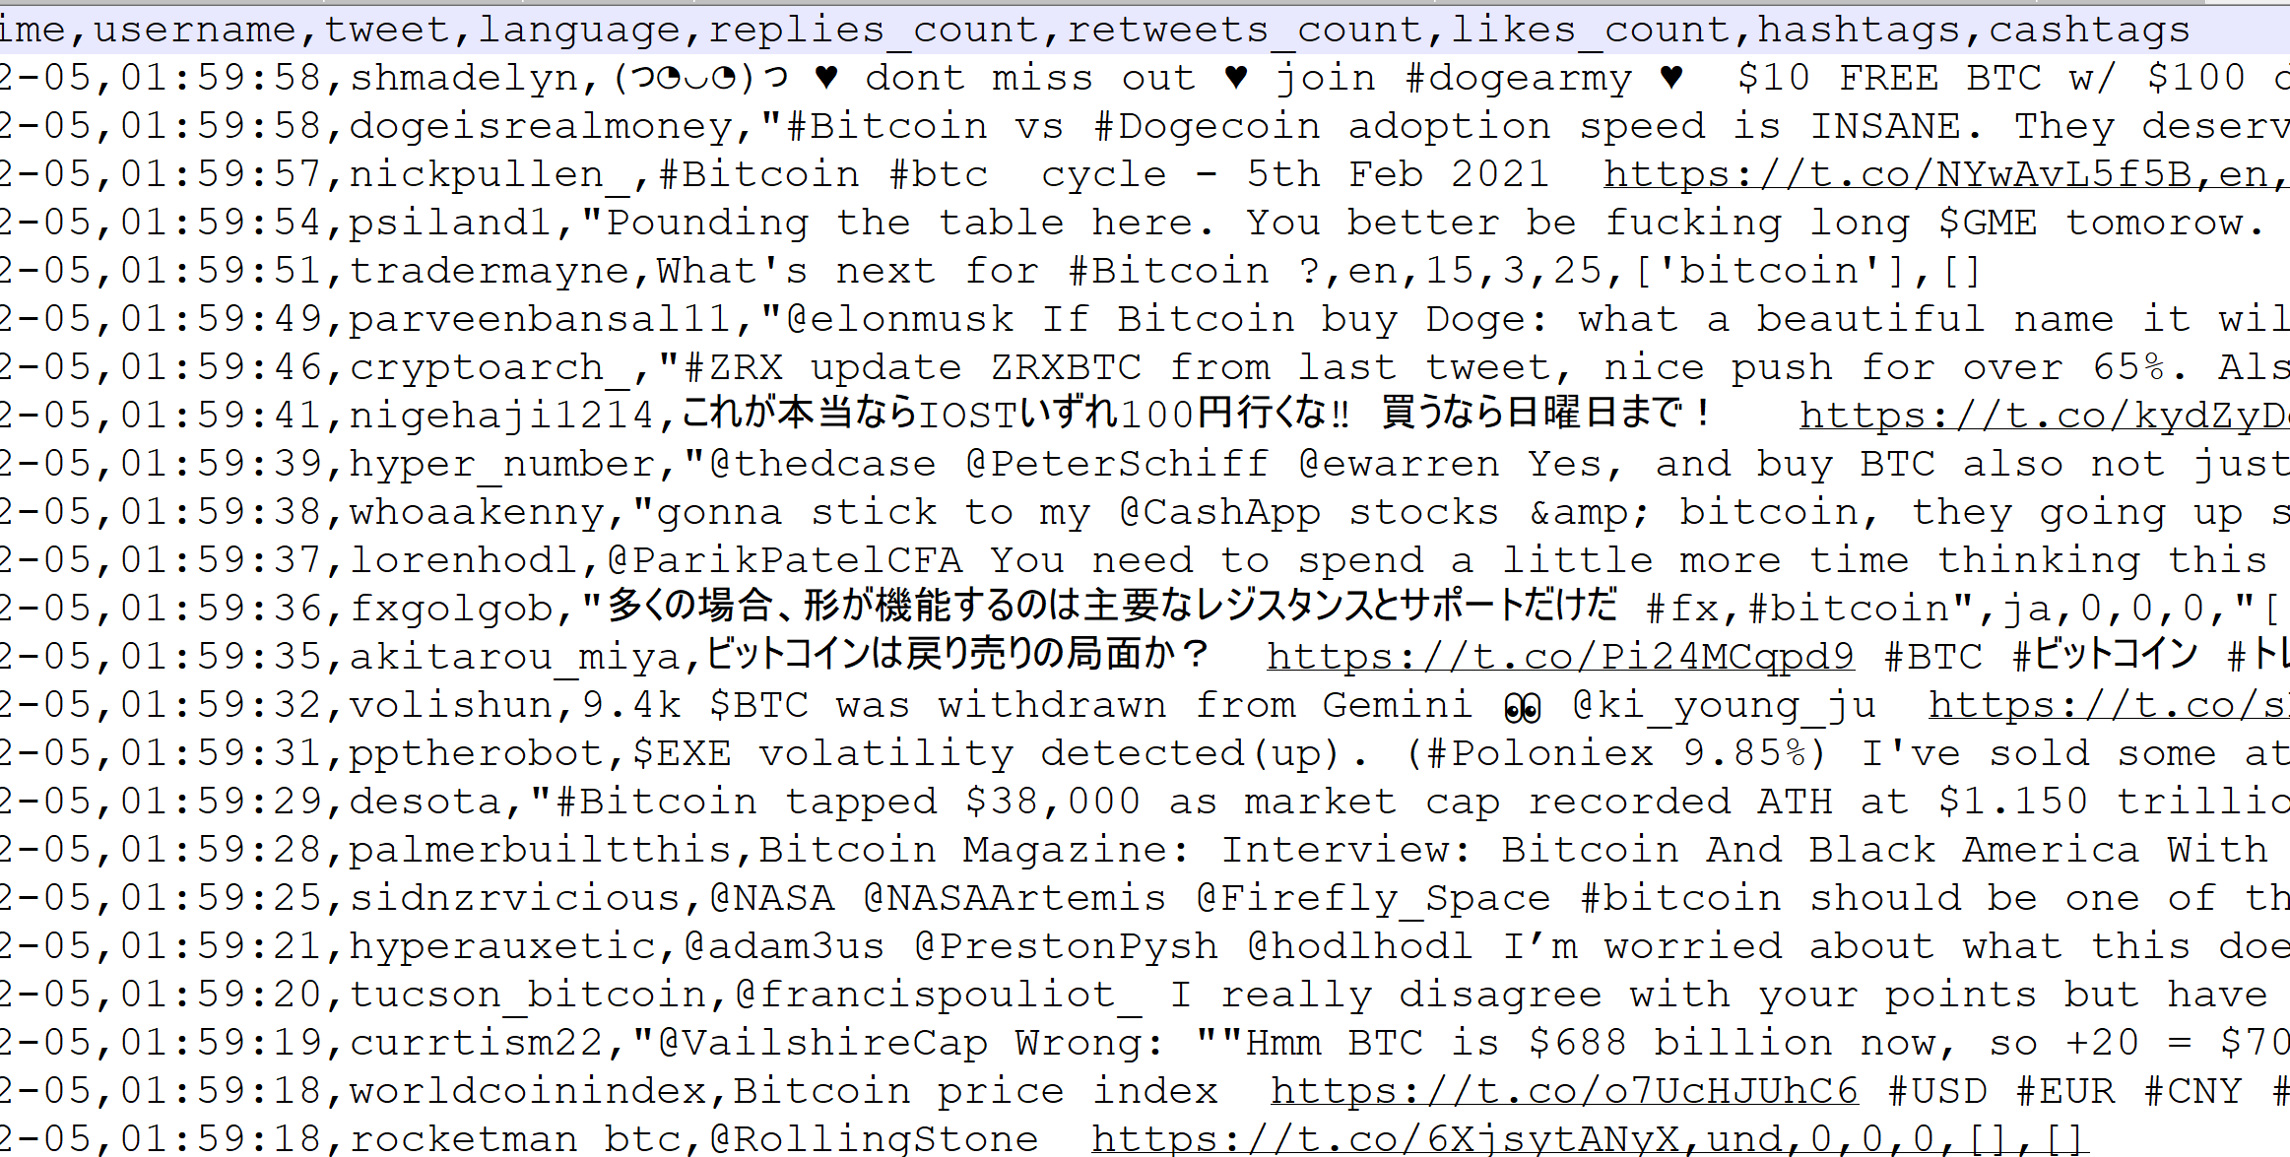
Our Raw Data
S&P Average Daily Price
1.4 Million tweets in a week
Raw Tweets and their metadata

Slide 7
Cleaning Data
NULLS on Weekends
 | Before | After
Weekday | XX | XX
Weekend | NULL | XX
Weekday | YY | YY
S&P Values are not recorded for weekends
Cryptocurrencies are traded 24/7 and therefore after joining the S&P daily prices with the cryptocurrency daily prices there were NULL values on the weekends. We filled the missing weekend values with the previous weekday’s value.
NULLS due to calculations
 | Change since Yesterday
First Day | NULL
Second Day | X%
Third Day | Y%
First and last rows
When calculating change since yesterday or if there will be a major change tomorrow, we received NULL values in the first and last rows due to missing information needed for those calculations. We dropped these rows.

Slide 8
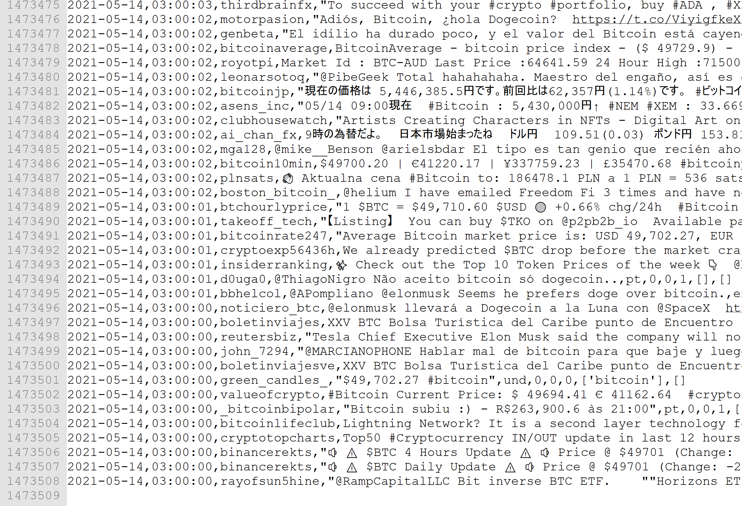
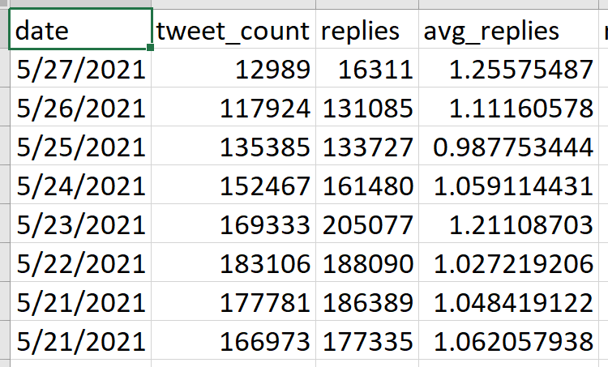
Transforming Data
Solution
Problem
We summarized each day into a single row in a new dataframe. The columns of this new data frame include tweet count, average likes, and counts of influential hashtags. This summarizes the data we’re most interested in.
The raw data was too large to work with, with an average of one million rows per week
Content Here

Slide 9
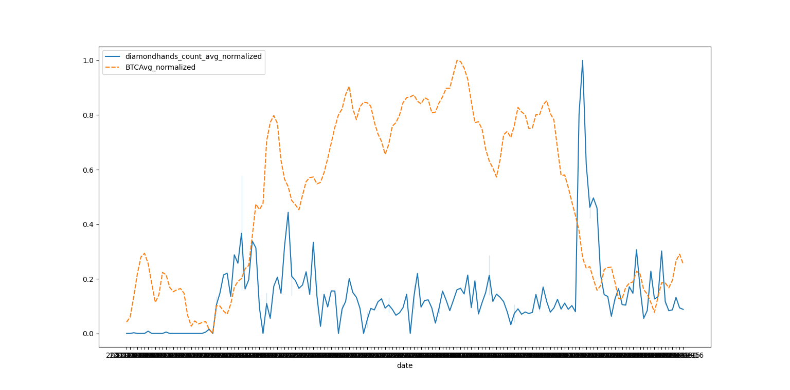
Visualizing our data
The relationship between the diamond hands hashtag and the price of Bitcoin.
The relationship seems to be inversed.

Slide 10
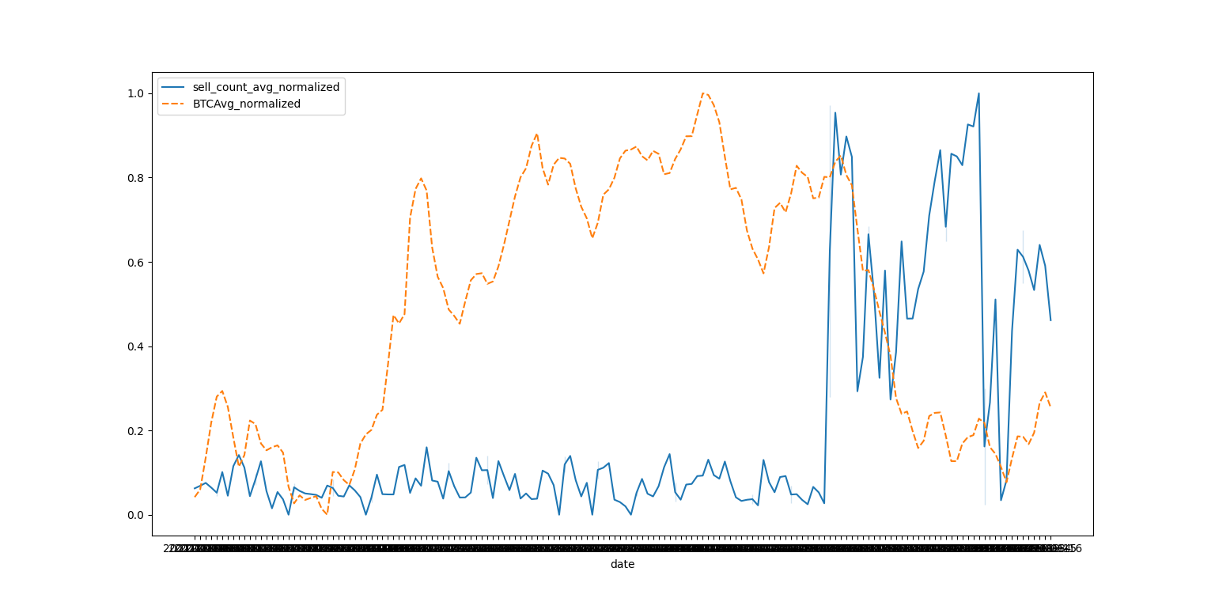
Visualizing our data
The relationship between the sell hashtag and the price of Bitcoin.
A spike in the sell hashtag corresponds with a major price drop in Bitcoin

Slide 11
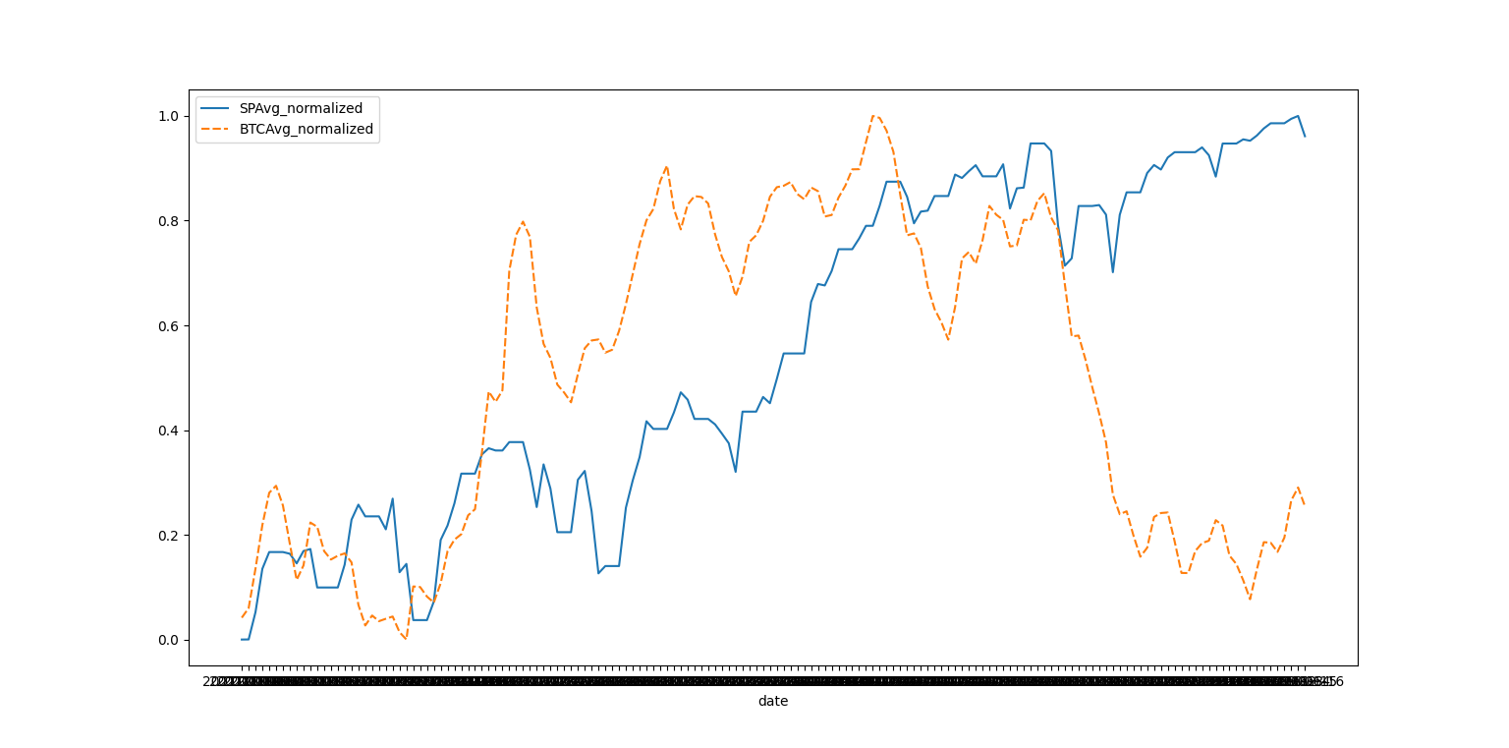
Visualizing our data
The relationship between the S&P 500 index and the price of Bitcoin.
We can see a that there is usually a direct relationship.

Slide 12

Data Modeling – Choosing an algorithm
We tried a few machine learning algorithms and we fed each of them various parameters and columns.
In the end we were deciding between Random Forest and Decision Tree.
We chose Random Forest as it was the most accurate in its predictions.

Slide 13
Attempted predictions
Major increase and decrease today
Major increase and decrease tomorrow
We attempted to predict whether Bitcoin’s price will increase or decrease by at least 5% on a given day
We attempted to predict whether Bitcoin’s price will increase or decrease by at least 5% on the day after a given day
Any increase and decrease today
Any increase and decrease tomorrow
We attempted to predict whether Bitcoin’s price will increase or decrease at all on a given day
We attempted to predict whether Bitcoin’s price will increase or decrease at all on the day after a given day

Slide 14
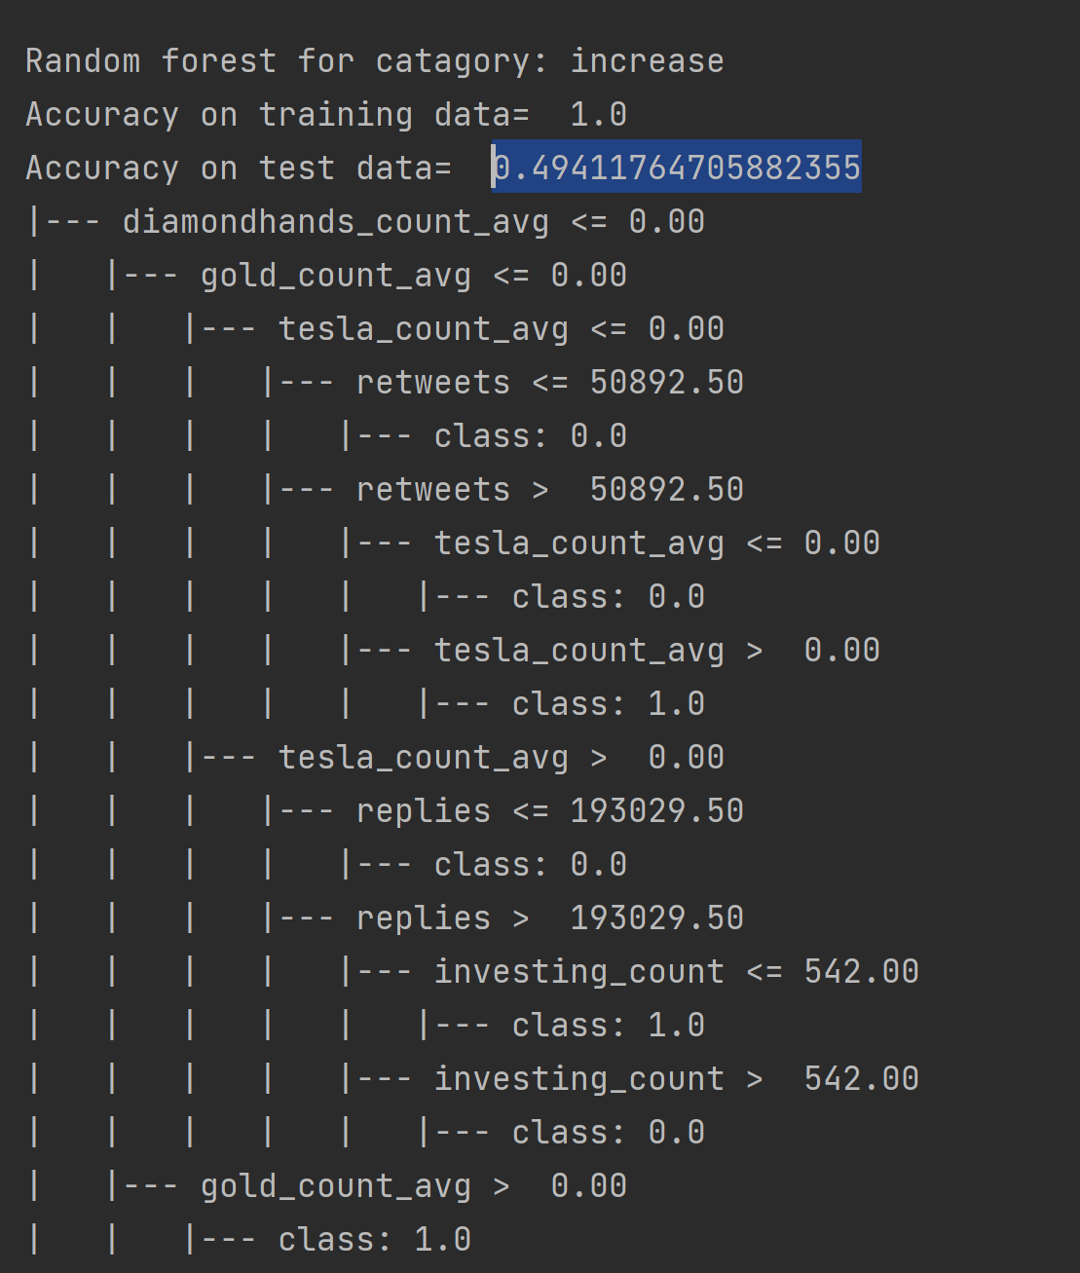
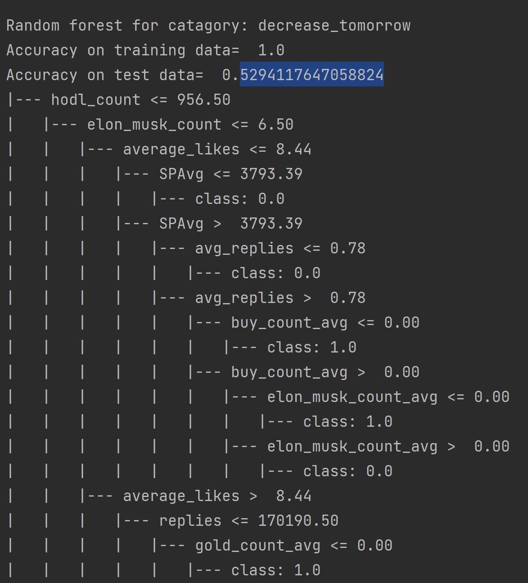
Failed predictions
We were unable to accurately predict an increase or decrease on a given day or the next day

Slide 15
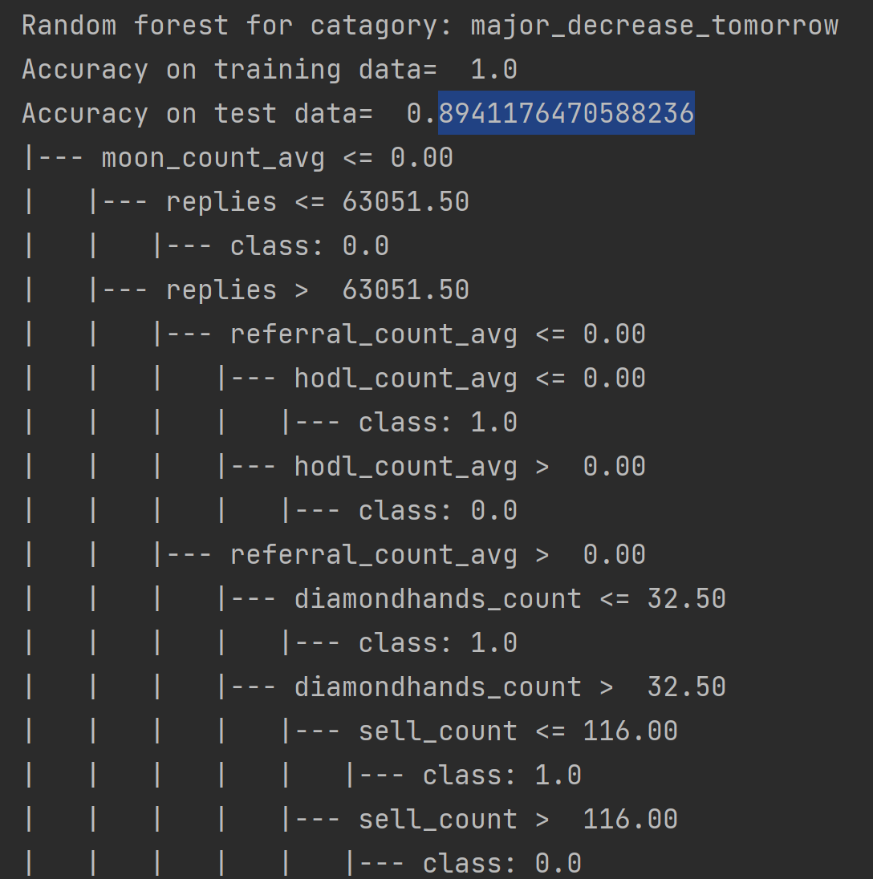
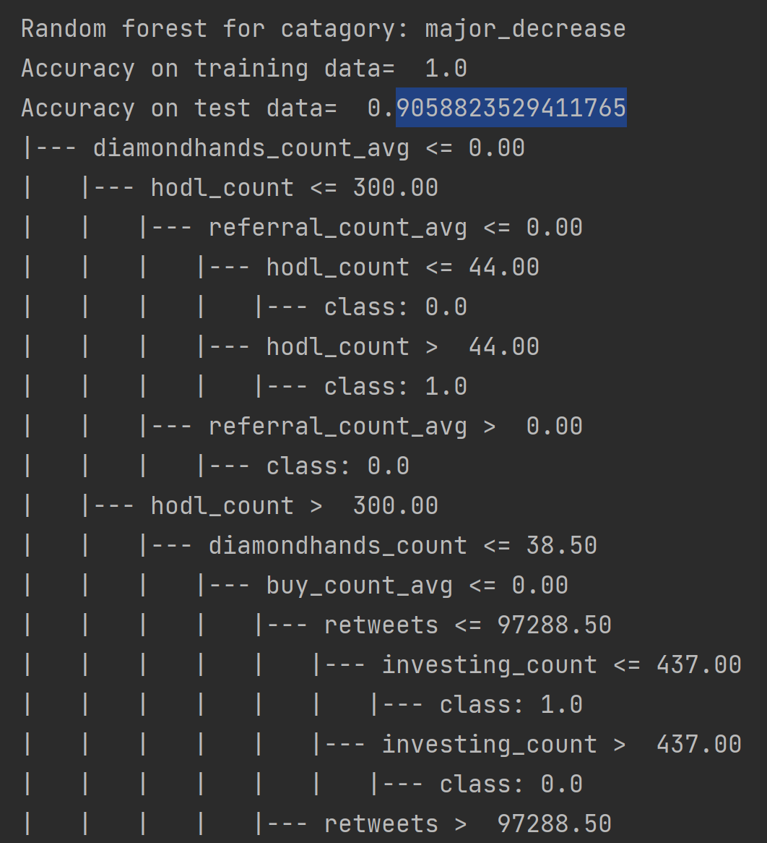
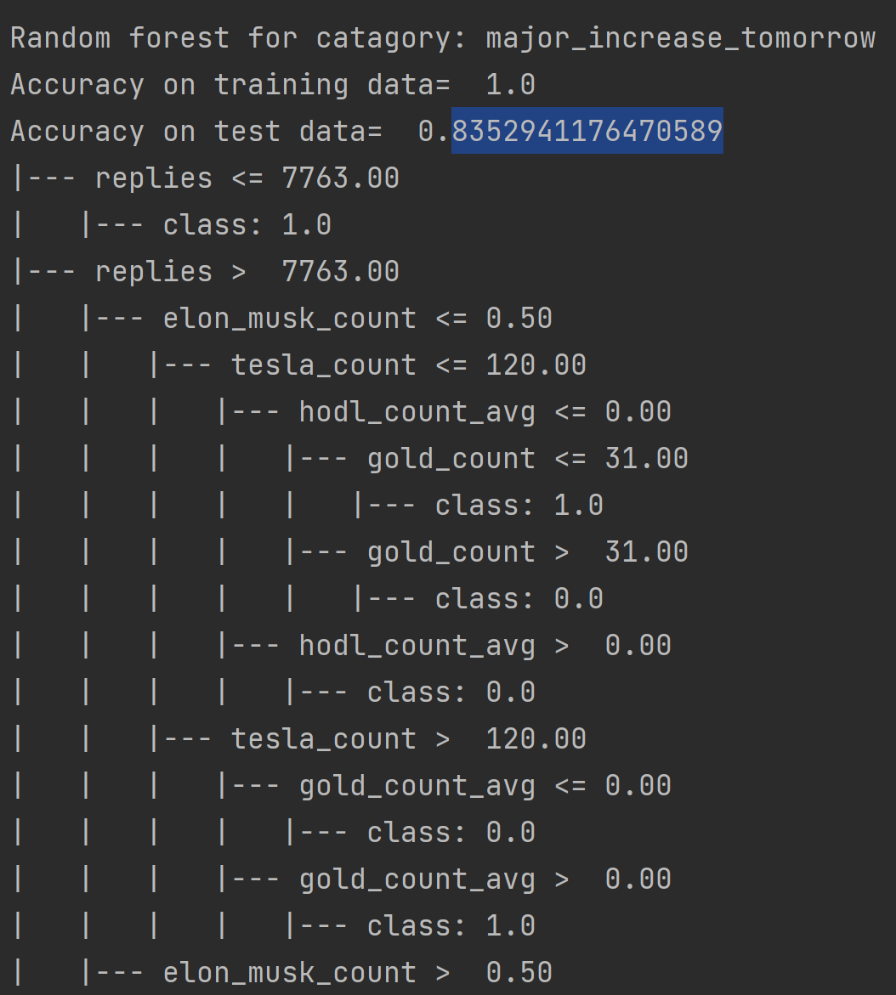
Successful predictions
We were able to accurately predict major increases and decreases on a given day or the next day

Slide 16

Conclusion
Content A
Get a modern PowerPoint Presentation that is beautifully designed. hope and I believe that this Template will your Time, Money and Reputation. Easy to change colors, photos and Text.
Predictions
We can accurately predict major price fluctuations, but not minor price fluctuations
Content B
Get a modern PowerPoint Presentation that is beautifully designed. hope and I believe that this Template will your Time, Money and Reputation. Easy to change colors, photos and Text.
Relationships
The price of Bitcoin is related to various social media keyword mentions and is also related to the S&P 500 Index
Content C
Get a modern PowerPoint Presentation that is beautifully designed. hope and I believe that this Template will your Time, Money and Reputation. Easy to change colors, photos and Text.

Slide 17
Next Steps
This project can be easily replicated on any cryptocurrency or stock, not only Bitcoin
Given more time, we could integrate the algorithm into an automatic day-trading bot which will buy and sell based on the predictions and will return a profit

